Slide 1

7 Grandfather Teachings for Early Years
Indigenous Learning Opportunities Project funded by the government of Canada and the province of ontario

Slide 2
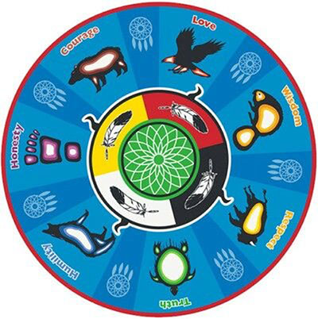
Seven Grandfather Teachings for Early Years
We reference these teachings often but how exactly do we really teach our children and families about these foundational values?
Learn how to build these values into the fabric of your program.
This session will provide participants with hands-on examples of how to instill traditional values in the next generation using proven techniques.

Slide 3
It Starts With A story
According to the story, long ago, a messenger sent to see how the Anishinaabe were living, discovered that the Amishinaabe were living their life in a negative way, which impacted their thoughts, decisions, and actions. Some had hate for others, displayed disrespectful actions, were afraid, told lies, and cheated. Others revealed pride or were full of shame. During his journey, the messenger came across a child. This child was chosen to be taught by the Seven Grandfathers to live a good life. He was taught the lessons of Love, Respect, Bravery, Truth, Honesty, Humility, and Wisdom.
Before departing from the Seven Grandfathers, they told him, “Each of these teachings must be used with the rest. You cannot have Wisdom without Love, Respect, Bravery, Honesty, Humility, and Truth. You cannot be Honest if you are only using one of the other teachings. To leave out one teaching would be embracing the opposite of what the teaching means.” The Seven Grandfathers each instructed the child with a principle. It was then up to the child to forget them, or to put them to use.
Each one of us represents the child. We must faithfully apply the teachings of our Seven Grandfathers to our own lives. We must place our trust in the Creator. We must also never forget to be sincere in our actions, character, and words.

Slide 4
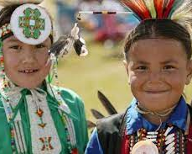
How was it taught?
Catch a child’s behavior that illustrates the Value
Label the Behavior
Reinforce the Definition of the Value
Reward the behavior
B+G Club example
It starts with us. Have we done this work as staff and our Program?

Slide 5
Value Exercise
Label the Value ___________________________________________
Define the Value __________________________________________
_________________________________________________________
_________________________________________________________
How will it affect the way we act at work?
_________________________________________________________
_________________________________________________________
_________________________________________________________
_________________________________________________________
_________________________________________________________
_________________________________________________________

Slide 6
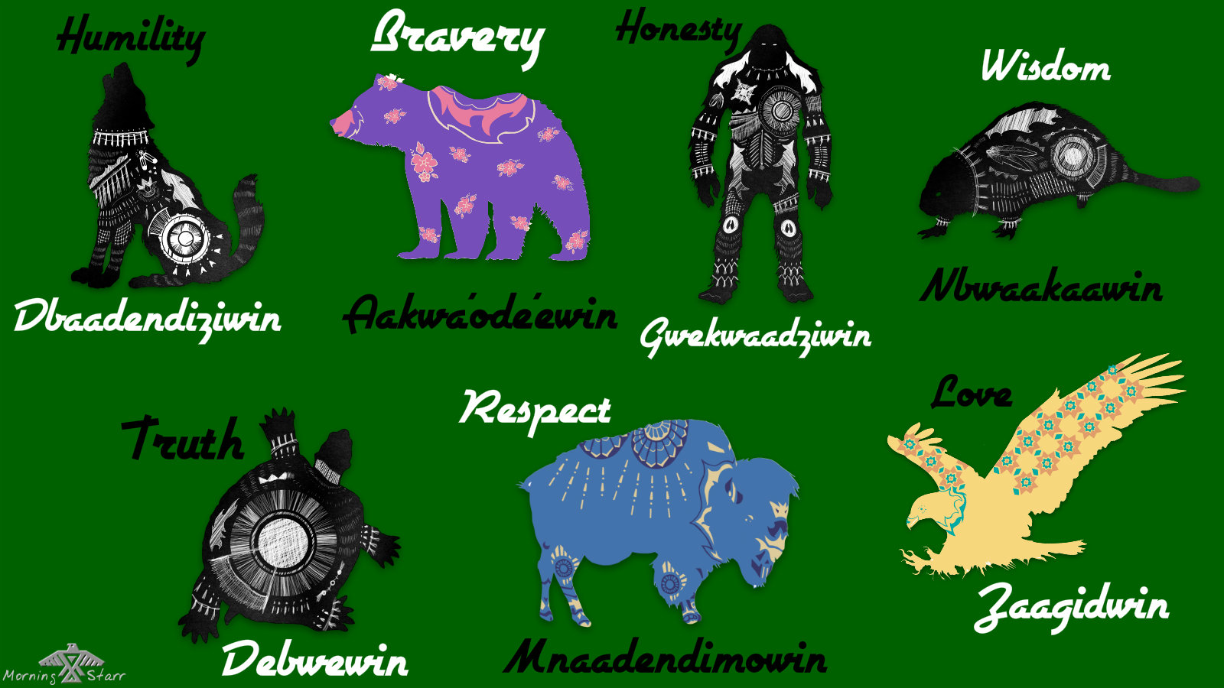
Our relatives

Slide 7
DEBWEWIN:Truth
Deb: The heart.
We: Sound through speech.
Win: Nominalizer. A way it is done.
Truth is the way it is in your heart.

Slide 8
DABASENDIZIWIN: Humility
Dabas: Low, Lower.
End: Pertaining to thought.
Izi: State or Condition.
Win: Nominalizer. A way it is done.
“To Think Lower of Oneself (in Relation to All That Sustains Us).”

Slide 9
MANAAJI’IDIWIN:Respect
Manaaji: To Go Easy on Someone.
Idi: In a Reciprocal Way.
Win: Nominalizer. A Way it is Done.
“To Go Easy on One Another”, meaning all of Creation.

Slide 10
NIBWAAKAAWIN:Wisdom
Waa: Pertaining to Sight.
Kaa: An Abundance
Win: Nominalizer. A way it is done.
“To Live with Vision”

Slide 11
ZOONGIDE’EWIN:Bravery
Zoongi: Solid, Strong, Unchanging.
De’e: A Form of “Heart.”
Win: Nominalizer. A Way it is Done.
“To Live with a Solid, Strong Heart,” regardless of fear, circumstances or consequences.

Slide 12
GWAYAKWAADIZIWIN:Honesty
Gwayak: Correctly, Straightly, and Rightly.
Aadizi: He/She Lives.
Win: Nominalizer. A way it is done.
“To Live Correctly and with Virtue.”

Slide 13
ZAAGI’IDIWIN:Love
Zaag: To Emerge naked, to Come Out, to Flow Out.
Idi: In a Reciprocal Way.
Win: Nominalizer. A Way it is Done.
“Unconditional Love Between One Another”, meaning all of Creation – including humans and non-humans, seen and unseen, of yesterday, today, and tomorrow.

Slide 14
Recognize a value in self, in creation, in others
Buy stuffed animals to represent the 7 Teachings corresponding animal.
Each month focus on one value/Teaching
Discuss the definitions and make a list of behaviors that illustrate that value. Continue to build that list at every opportunity and visit it every day.
Catch, label, reward (which can be that child gets to hold the stuffie for the day) and helps the child recognize that value in themselves.
Illustrate the value in Nature either with videos or a nature walk so they recognize that teaching in Creation around them.
On the last week of the month, 1 child per day gets to “award” the stuffie to another child and explain WHY. This helps them recognize those teachings in others.
Colouring pictures and going on scavenger hunts related to the Value can reinforce the learning.

Slide 15
Examples of resources
https://www.publicboard.ca/News/HomeStudyandStudentCurriculumResources/WeekataGlanceApril6-10/Documents/Open%20Minds%20-%20Primary%20Week%201.pdf
http://rover.edonline.sk.ca/system/guides/R054842.pdf

