Slide 1

Use Zoom to play games with your Families
Indigenous Learning Opportunities Project funded by the government of Canada and the province of Ontario

Slide 2
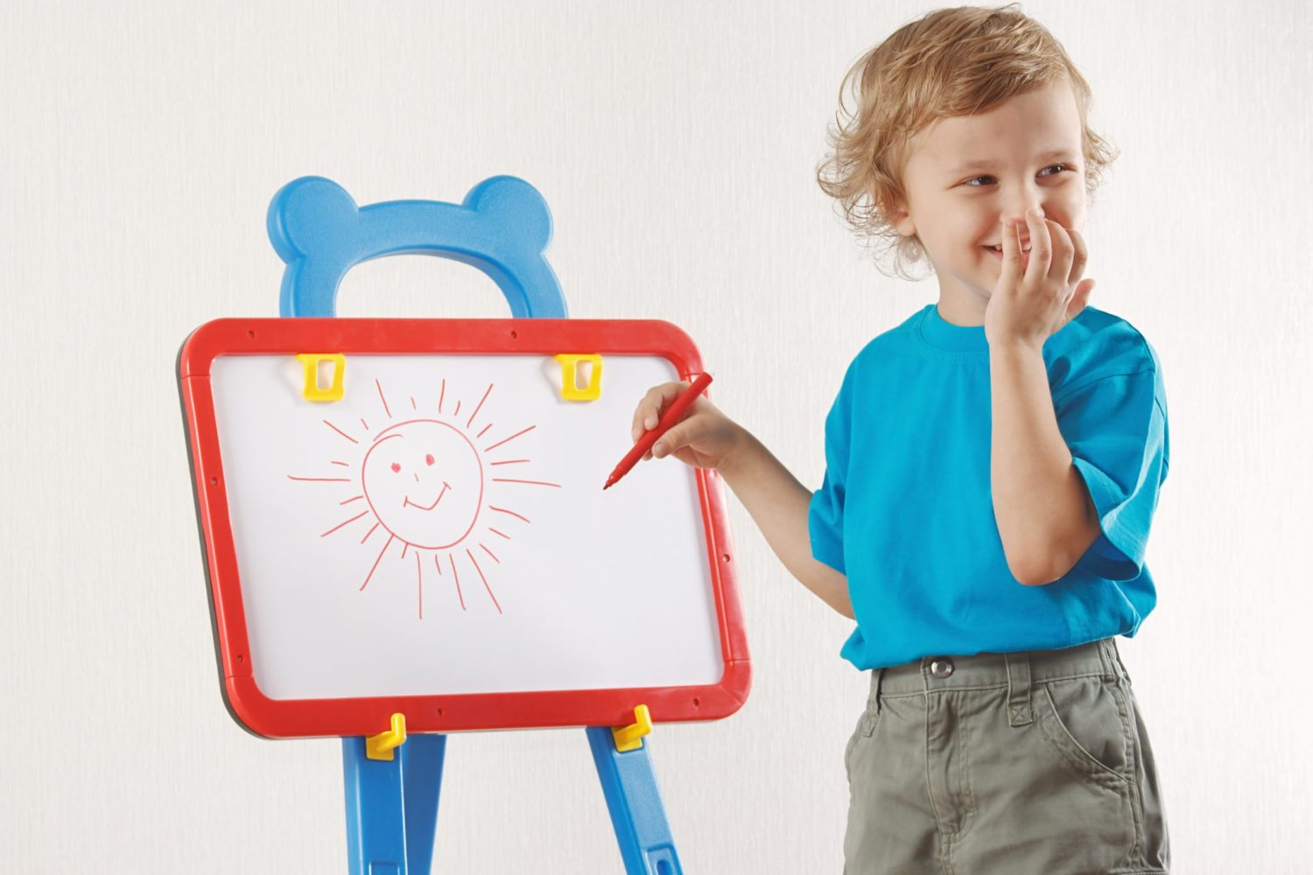
How to Play Pictionary on Zoom
Learn how to use the tools on Zoom to engage your families and children in games like Pictionary
Keep your families connected even when we have to social distance or when travel becomes an issue
Learn variations of this approach to modify the game or even play charades!

Slide 3
What are the rules of the game?
The rules of the game are simple. One person on your team is designated to be the first person to draw a picture of whatever random Pictionary word is generated.
Once they see the word, they have 5 seconds to think before they begin to draw.
Once they begin drawing, they have 1 minute to try to get their partner to guess the random word. If the partner succeeds in guessing the correct word being drawn, the team gets a point, but they get zero points if they don’t.
Team two does the same thing, then the person drawing is switched for round two. After a designated number of rounds, the team with the most points wins.

Slide 4
What is the difference between Pictionary and charades?
The main difference between Pictionary and charades is how the person tries to communicate the word their teammates is supposed to guess. In Pictionary the person draws the word to be guessed while in charades the person acts out the word to be guessed.
Four our purposes, one person will act as the Host who generates the word and sends it to the drawer/actor in a private message. More on that later.
The Host will also act as the Time Keeper and Score Keeper.
www.radomwordgenerator.com/pictionary.php

Slide 5
Setting up Zoom
Go to www.zoom.us and create an account if you don’t have one
Go to My Account and click on Settings then In Meeting Basic
Make sure you enable Chat and Private Chat
Make sure you enable Screen Sharing and Whiteboard
You can also enable these features right in the Zoom meeting window
Practice with the Whiteboard features ahead of time and show them to the participants
This does not work well with smartphones
Let’s Play!

Slide 6
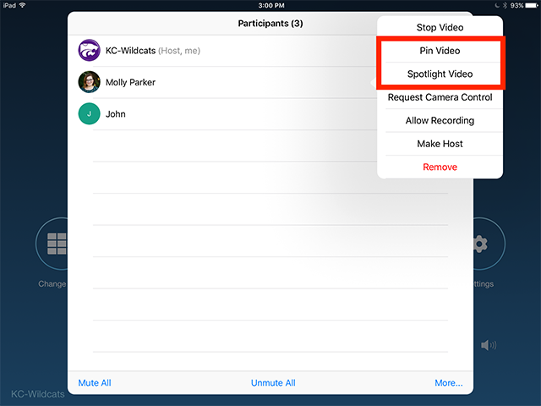
Considerations
Smaller children may not be adept at manipulating the mouse. You can have them draw on paper at home and raise the drawing for the camera.
You can give more time for drawing depending on age
Instead of teams, you can have one person draw and everyone else guess
You can use the word generator and play charades instead. The Host can spotlight the actor so they take up the entire screen during their turn.
Spotlight video puts a user as the primary active speaker for all participants in the meeting. To spotlight, you need at least 3 participants in the meeting with their video on and can only be done by the host.

